Slide 1
SONA Alternate Assignment Guide
Reminder: This alternate assignment is ONLY available weeks 6-8 of the quarter.

Slide 2
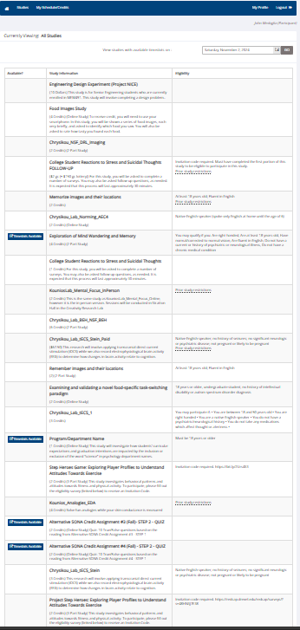
Log into SONA using your credentials as described in the general SONA instructions on Blackboard.
Admittedly, this list of studies is unwieldy to say the least.

Slide 3
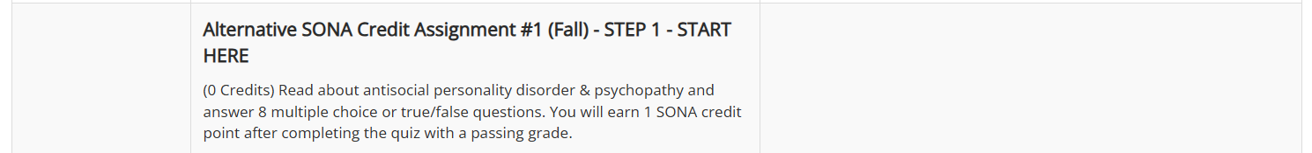
Unfortunately, the assignments are out of order and mixed in with actual studies.
You cannot use the “Available?” Column as a cue because “STEP 1” of each assignment will not have “slots.”
Instead, simply search for and do these things in this order until you have a total of 6 credits between any experiments you participated in and the alternate assignments

Slide 4
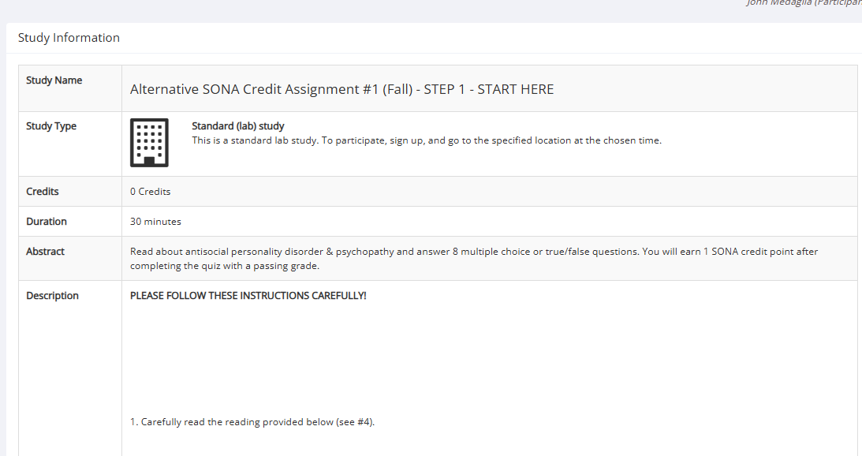
Unfortunately, the assignments are out of order and mixed in with actual studies.
You cannot use the “Available?” Column as a cue because “STEP 1” of each assignment will not have “slots.” For each “STEP 1” you need to click on the link instead.
For each assignment STEP 1, there won’t be “Timeslots Available”…
…so click this link to see the content instead and…
…follow the instructions you see inside!

Slide 5
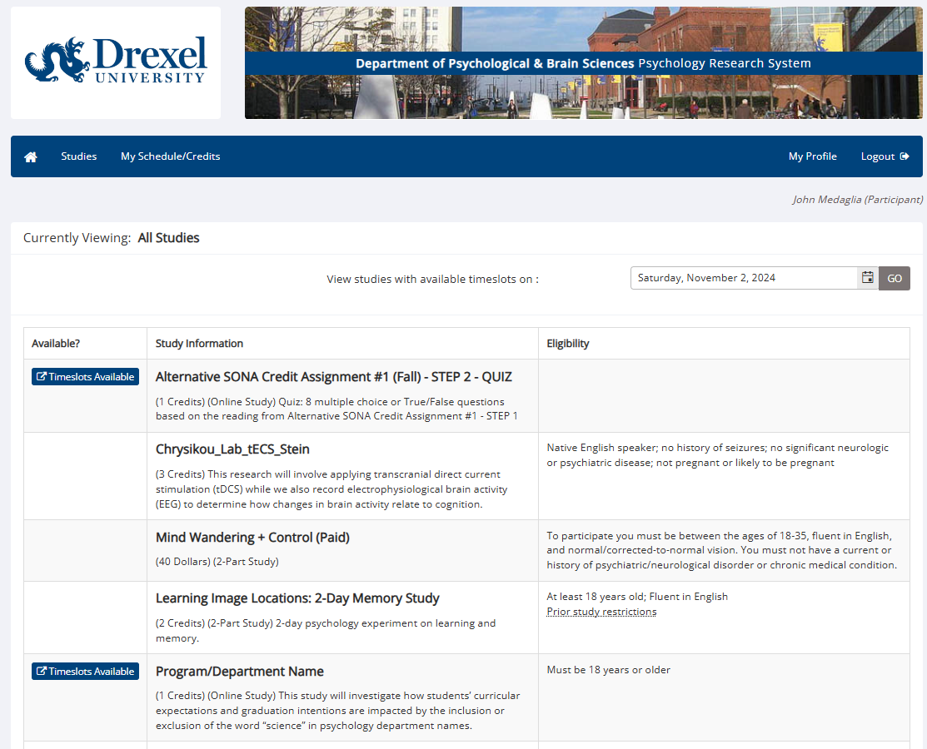
After you read the required content, the instructions for each assignment will tell you to go to STEP 2 for that assignment. You will need to find it on the “Studies” tab again.

Slide 6
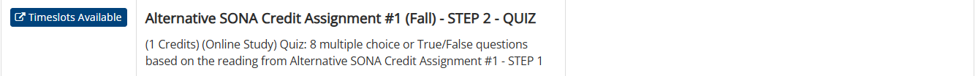
After you read the required content, the instructions for each assignment will tell you to go to STEP 2 for that assignment. You will need to find it on the “Studies” tab again. For example, after you complete Assignment #1 STEP 1, you are looking for this. You can click either” Timeslots Available” or the title to enter the assignment:
Clicking either of these will work for each assignment’s STEP 2

Slide 7
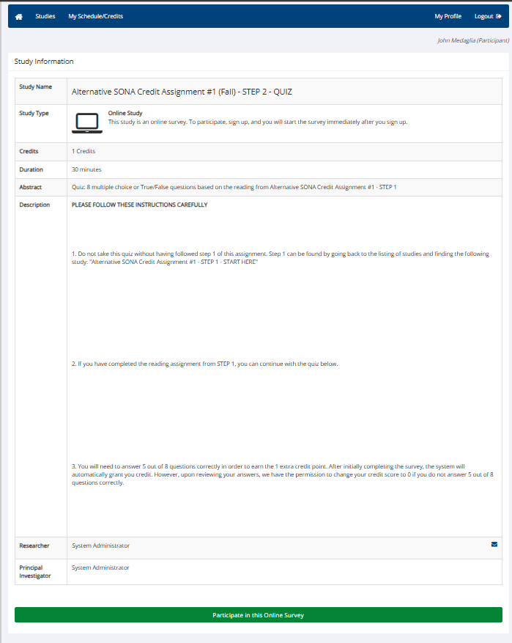
After you click into STEP 2 for the assignment, you will see a view like this. Read the instructions, then click “Participate in the Online Survey” to do the assignment and earn your credits.

Slide 8
To help you find the assignment STEP 1 and STEP 2 for each of 4 assignments faster, here are their names in the Studies tab. Do them in this order:
Alternative SONA Credit Assignment #1 (Fall) - STEP 1 - START HERE
Alternative SONA Credit Assignment #1 (Fall) - STEP 2 - START HERE
Alternative SONA Credit Assignment #2 (Fall) - STEP 1 - START HERE
Alternative SONA Credit Assignment #2 (Fall) - STEP 2 - START HERE
Alternative SONA Credit Assignment #3 (Fall) - STEP 1 - START HERE
Alternative SONA Credit Assignment #3 (Fall) - STEP 2 - START HERE
Alternative SONA Credit Assignment #4 (Fall) - STEP 1 - START HERE
Alternative SONA Credit Assignment #4 (Fall) - STEP 2 - START HERE

